Slide 1


EU-CIP Annual Conference in Madrid 13.11.2024
Online integrative hub for strategic cyber-physical resilience solutions for water utilities
Dr. Dionysios Nikolopoulos
Tethys Consulting (https://tethys-consulting.com)
email: nikolopoulos.dio@gmail.com

Slide 2

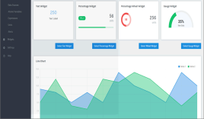
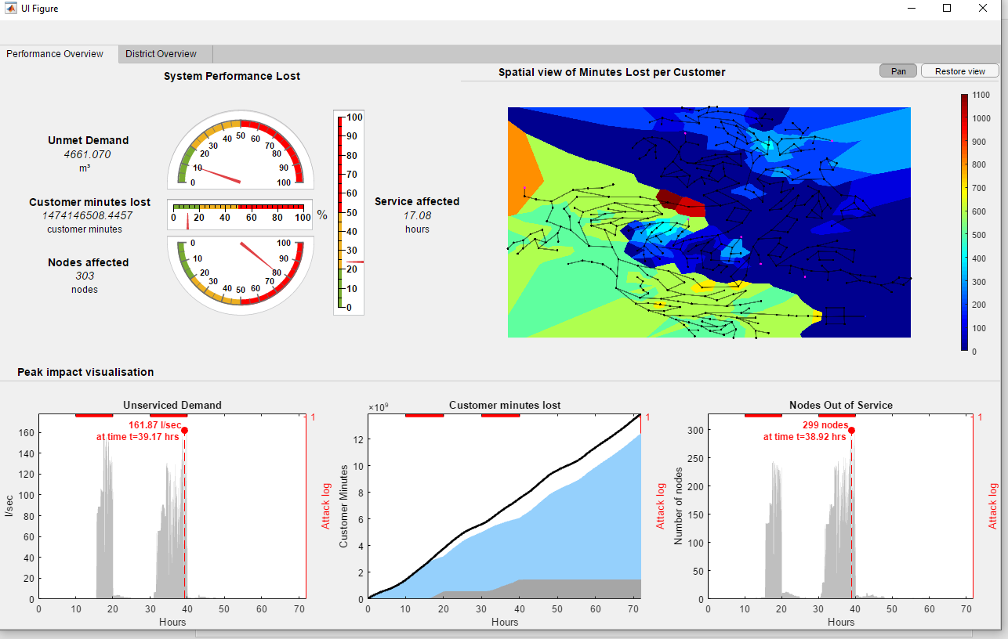
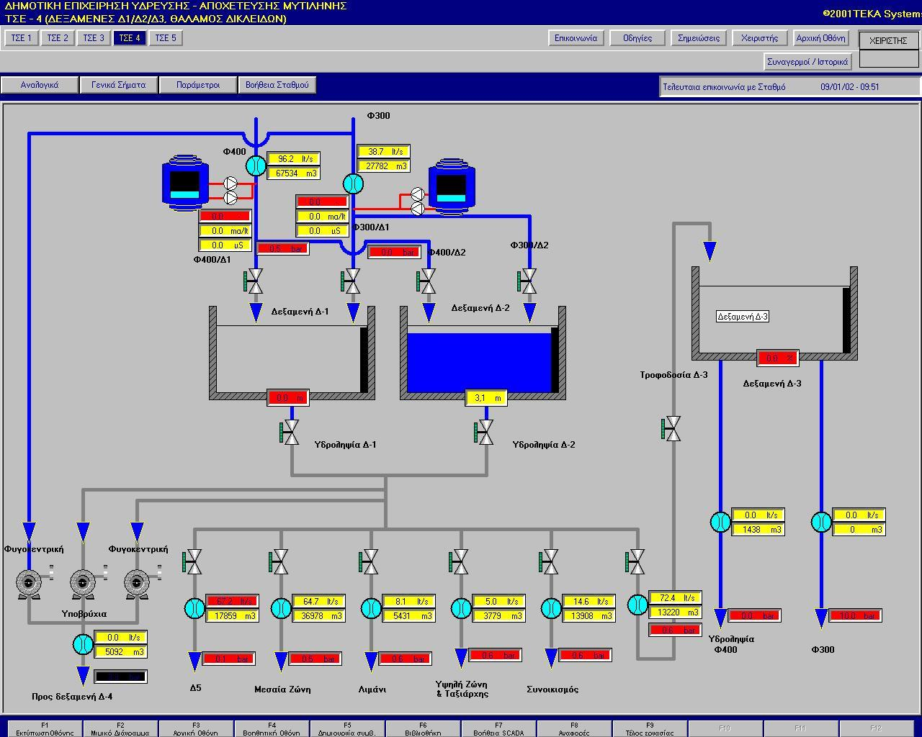

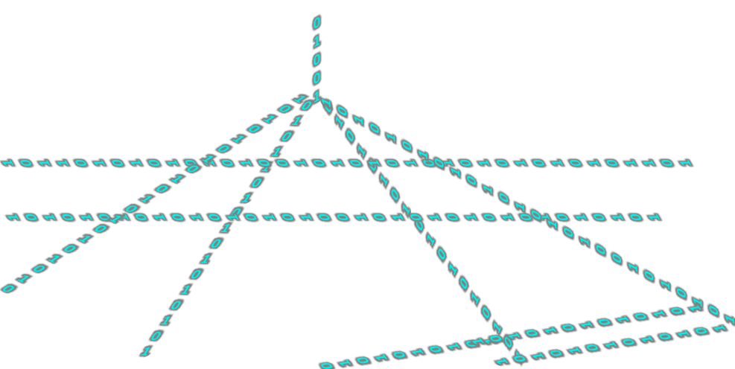
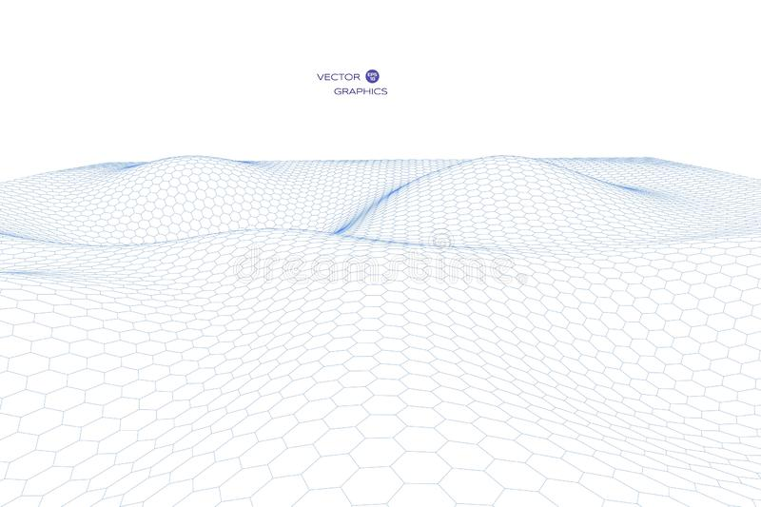
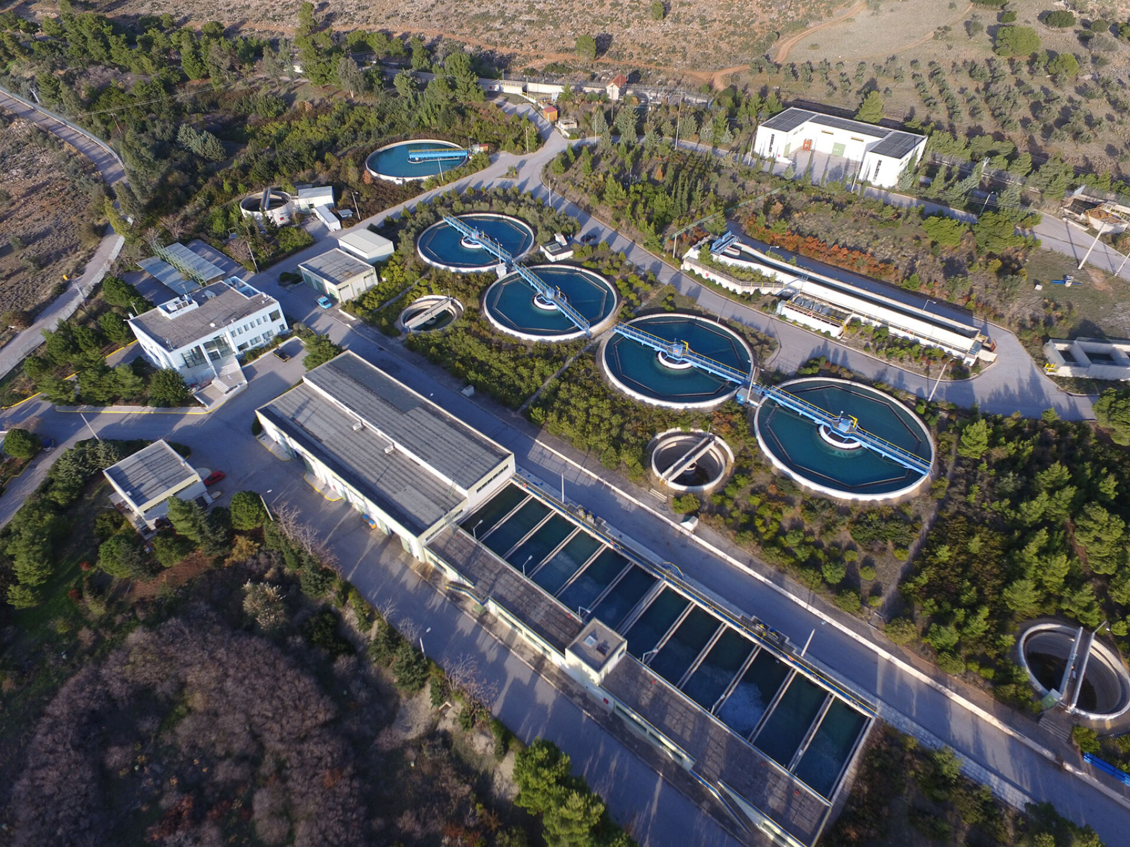
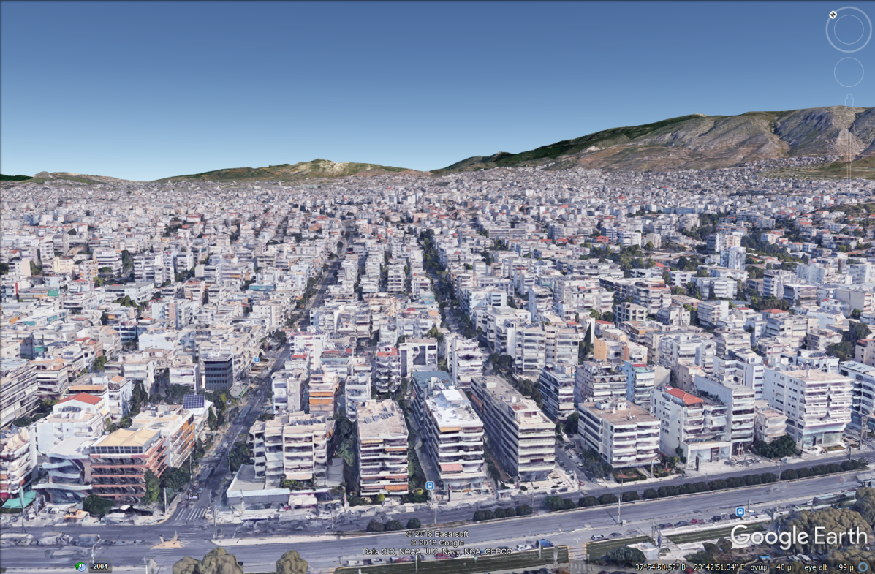
Water Systems Transforming into CPSs
0101010101010100
1101010
0101010101010100
1101010
Water infrastructure is becoming digitalized with new sensors and
real-time online control & monitoring.
SCADA
01010101010
01010101010
01010101
0101
0101
1010101
01

Slide 3


The Sector’s Needs for Critical Infrastructure Protection
Digitalized water utilities are increasingly becoming prime targets for cyber-physical attacks.
WHERE
WHO attacks
Alarming increase of attacks on EU Water CPSs! Median cost of incidents: 200,000€
Individuals
EU directives require harmonization & practical implementation
Revised DWD
Hacktivists - Terrorists
Organized Crime
NIS2 Directive
CER Directive
State-sponsored cyber warfare
WHAT could be the effect
Water supply cut-off
Water supply pollution
Monetary & reputational damages
Health concerns
Security concerns

Slide 4




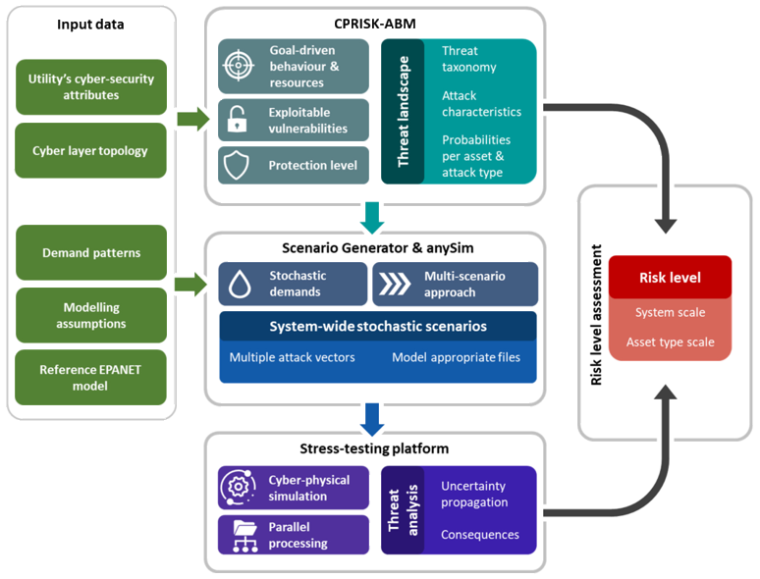










Our Solution: PROCRUSTES
Integrated hub for
cyber-wise water utilities
Identification & quantification of CP risks & vulnerabilities via ABM modelling
Resilient & optimized
water sensor placement
Automated definition of CP attack scenarios
Stochastic scenarios to capture uncertainty
Analysis of alternatives
Risk-reduction measures knowledge database
Cyber-physical stress-testing of water distribution systems

Slide 5
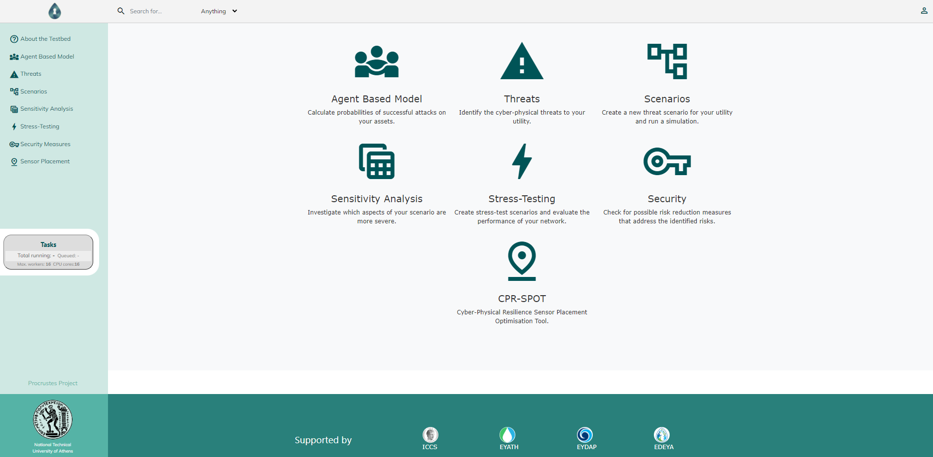
Our Solution: PROCRUSTES
Integrated hub for
cyber-wise water utilities
Identification & quantification of CP risks & vulnerabilities via ABM modelling
Resilient & optimized
water sensor placement
Automated definition of CP attack scenarios
Stochastic scenarios to capture uncertainty
Analysis of alternatives
Risk-reduction measures knowledge database
Cyber-physical stress-testing of water distribution systems

Slide 6
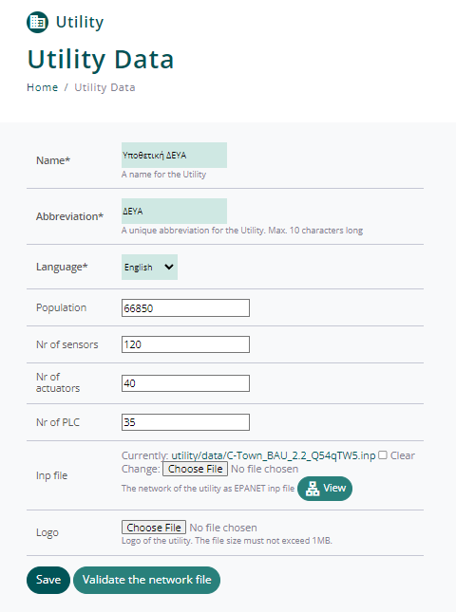
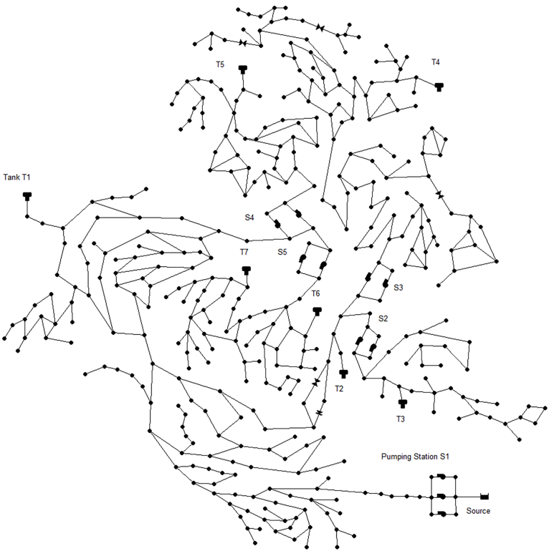
Our Solution: PROCRUSTES
Integrated hub for
cyber-wise water utilities
Identification & quantification of CP risks & vulnerabilities via ABM modelling
Resilient & optimized
water sensor placement
Automated definition of CP attack scenarios
Stochastic scenarios to capture uncertainty
Analysis of alternatives
Risk-reduction measures knowledge database
Cyber-physical stress-testing of water distribution systems

Slide 7
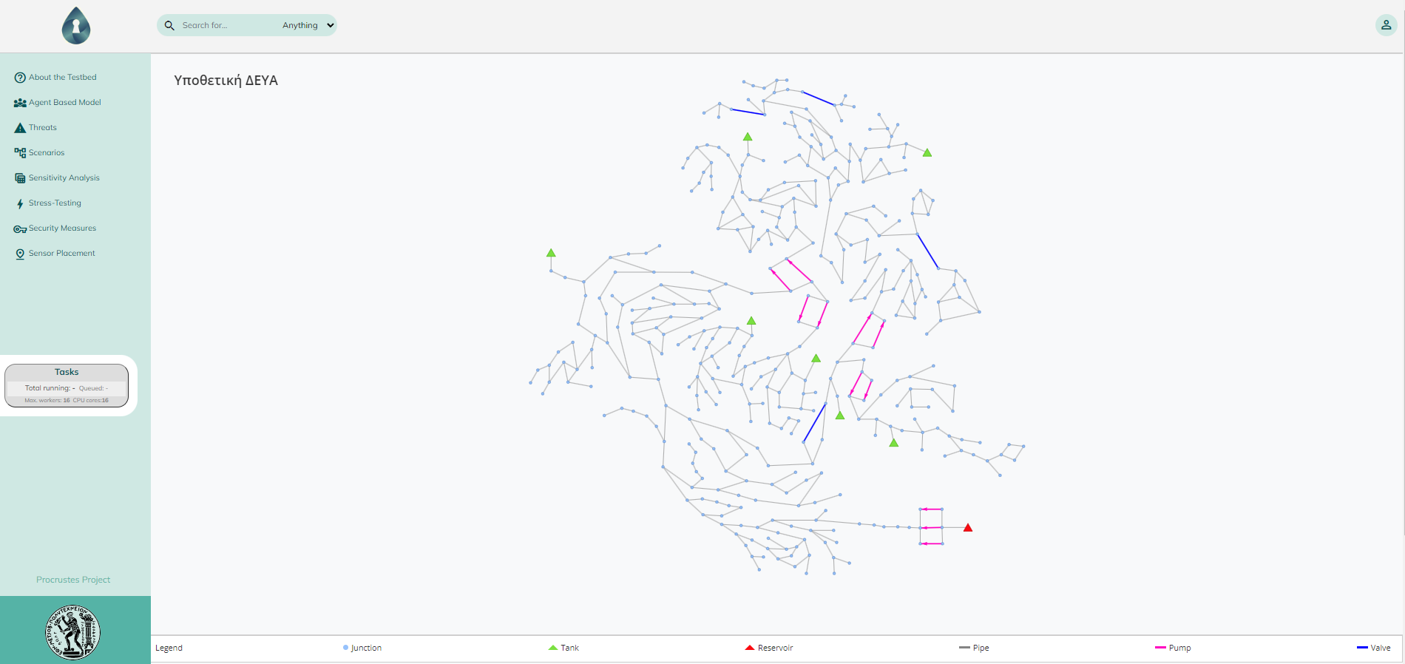
Our Solution: PROCRUSTES
Integrated hub for
cyber-wise water utilities
Identification & quantification of CP risks & vulnerabilities via ABM modelling
Resilient & optimized
water sensor placement
Automated definition of CP attack scenarios
Stochastic scenarios to capture uncertainty
Analysis of alternatives
Risk-reduction measures knowledge database
Cyber-physical stress-testing of water distribution systems

Slide 8
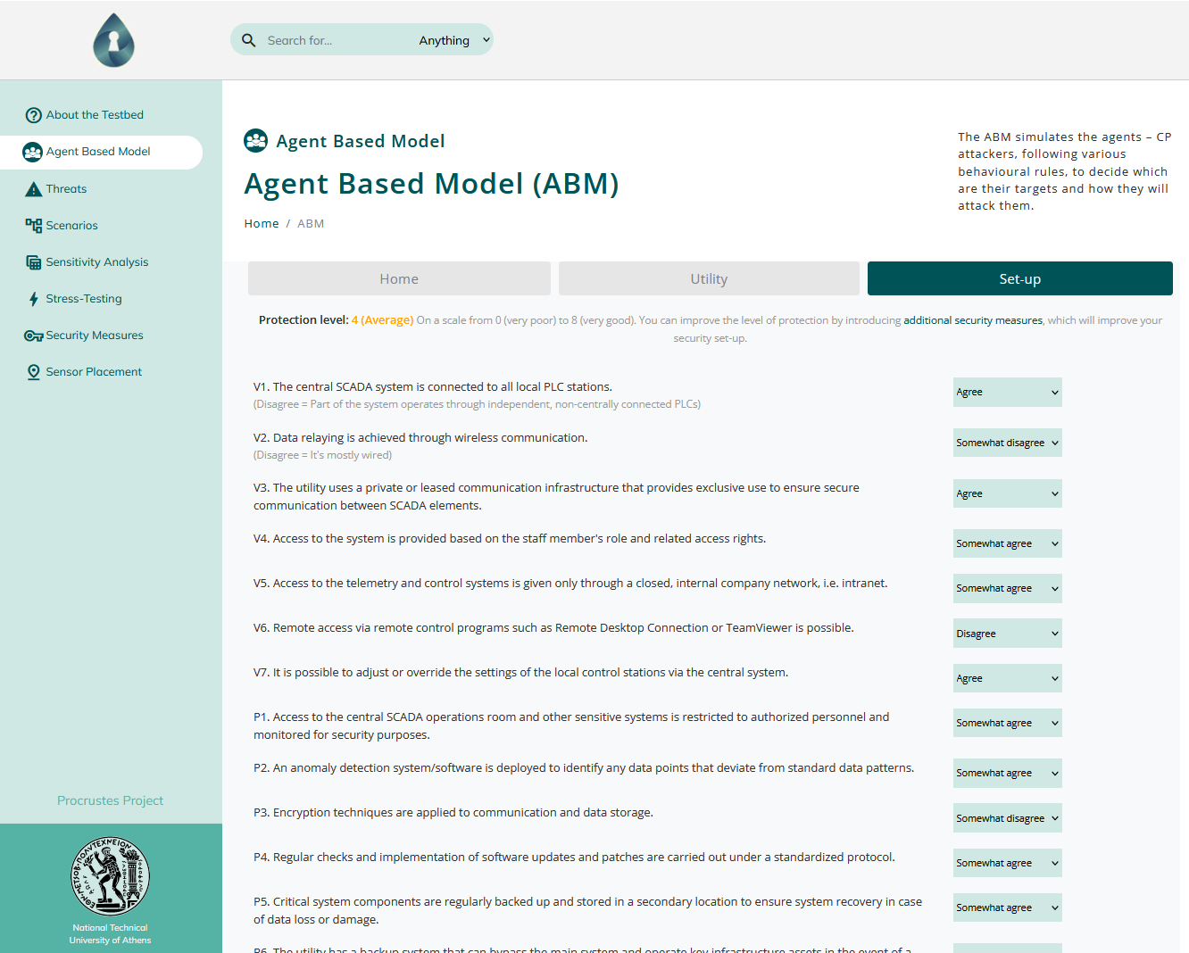
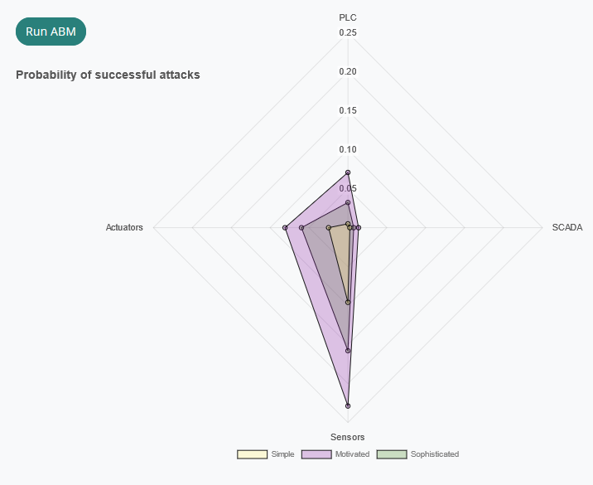
Our Solution: PROCRUSTES
Integrated hub for
cyber-wise water utilities
Identification & quantification of CP risks & vulnerabilities via ABM modelling
Resilient & optimized
water sensor placement
Automated definition of CP attack scenarios
Stochastic scenarios to capture uncertainty
Analysis of alternatives
Risk-reduction measures knowledge database
Cyber-physical stress-testing of water distribution systems

Slide 9
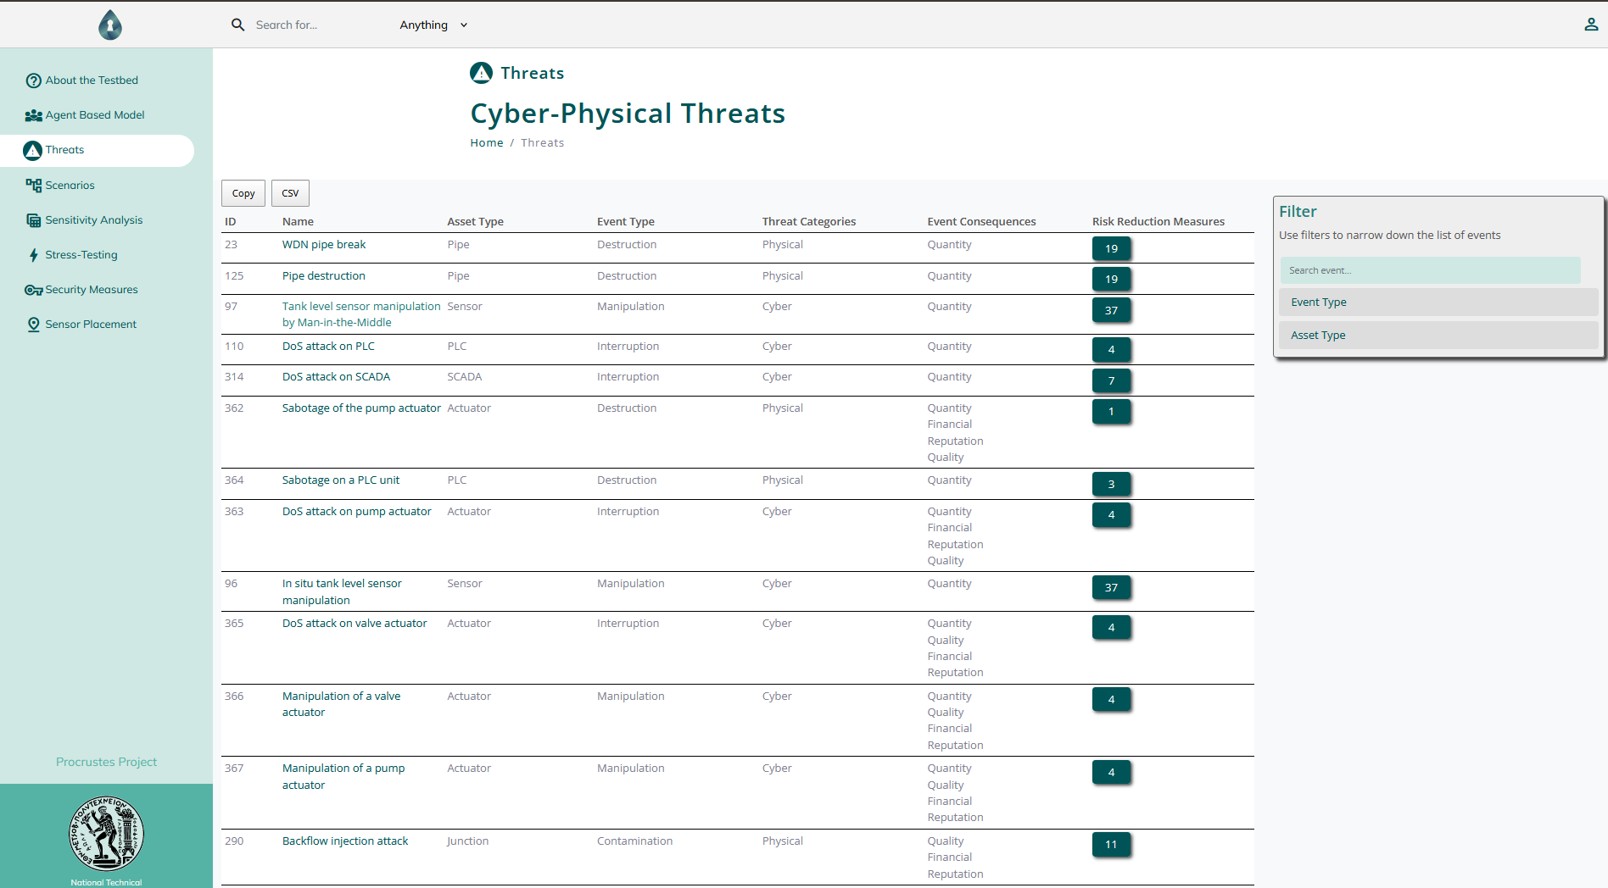
Our Solution: PROCRUSTES
Integrated hub for
cyber-wise water utilities
Identification & quantification of CP risks & vulnerabilities via ABM modelling
Resilient & optimized
water sensor placement
Automated definition of CP attack scenarios
Stochastic scenarios to capture uncertainty
Analysis of alternatives
Risk-reduction measures knowledge database
Cyber-physical stress-testing of water distribution systems

Slide 10
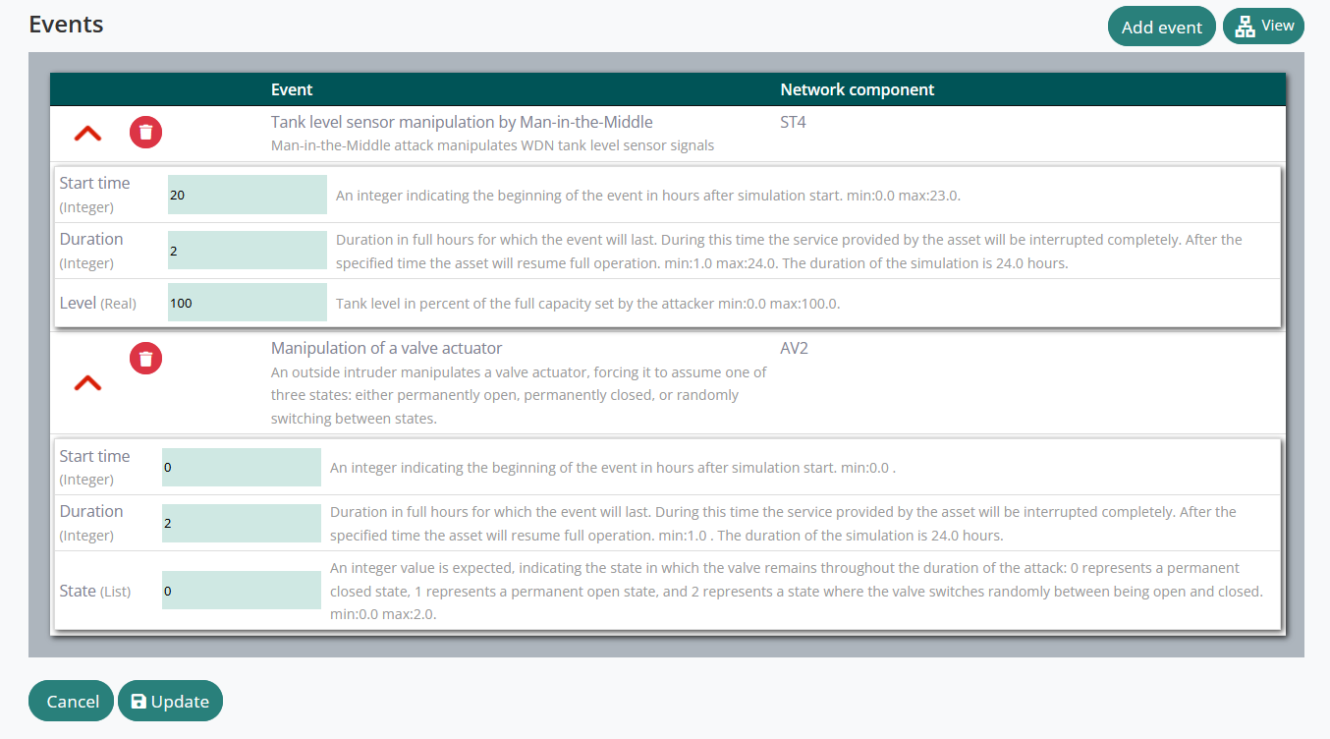
Our Solution: PROCRUSTES
Integrated hub for
cyber-wise water utilities
Identification & quantification of CP risks & vulnerabilities via ABM modelling
Resilient & optimized
water sensor placement
Automated definition of CP attack scenarios
Stochastic scenarios to capture uncertainty
Analysis of alternatives
Risk-reduction measures knowledge database
Cyber-physical stress-testing of water distribution systems

Slide 11
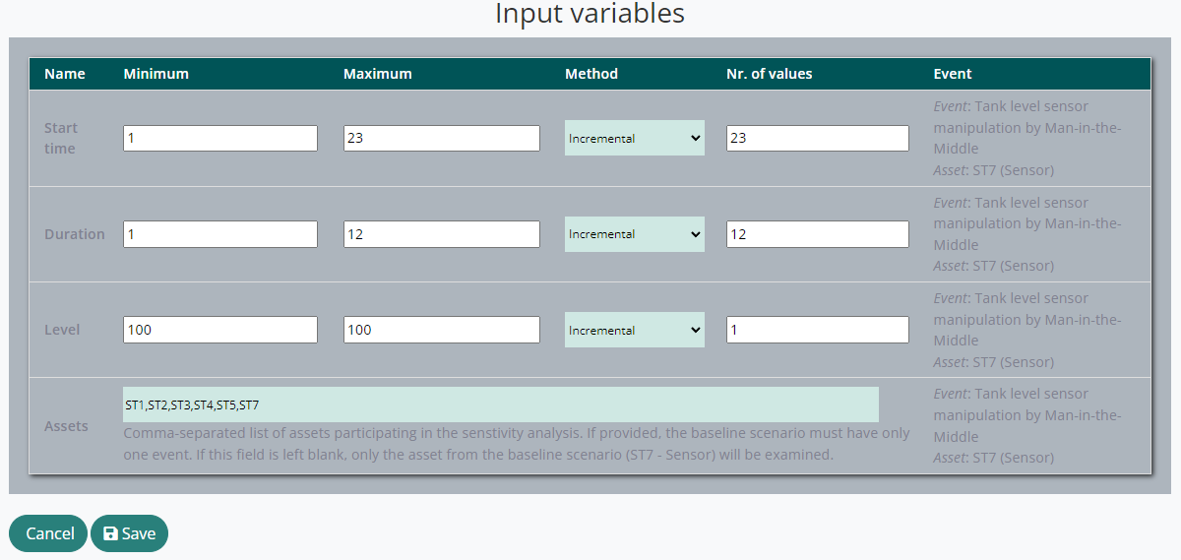
Our Solution: PROCRUSTES
Integrated hub for
cyber-wise water utilities
Identification & quantification of CP risks & vulnerabilities via ABM modelling
Resilient & optimized
water sensor placement
Automated definition of CP attack scenarios
Stochastic scenarios to capture uncertainty
Analysis of alternatives
Risk-reduction measures knowledge database
Cyber-physical stress-testing of water distribution systems

Slide 12
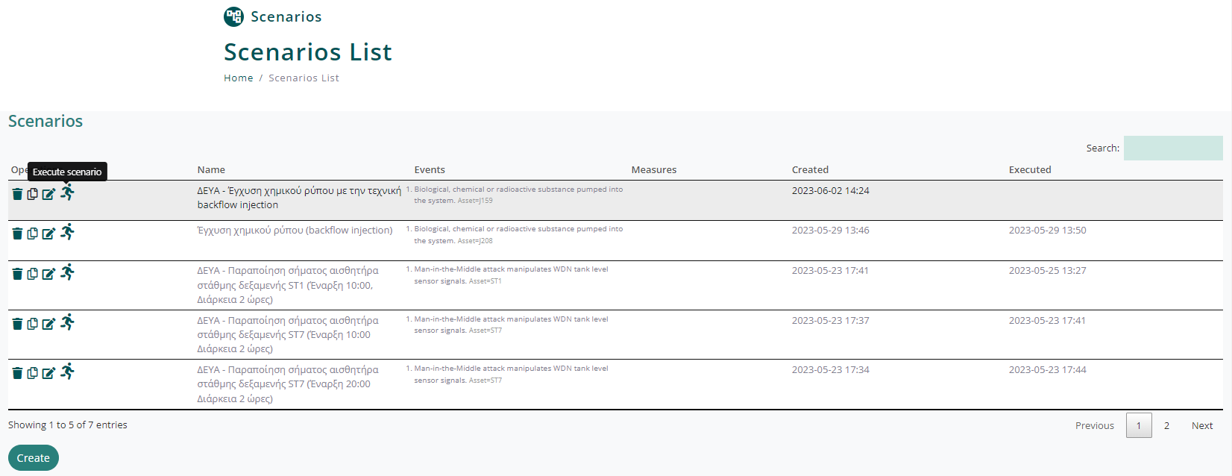
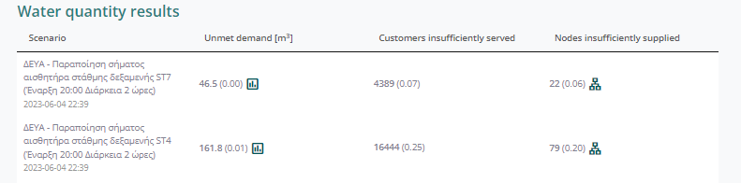
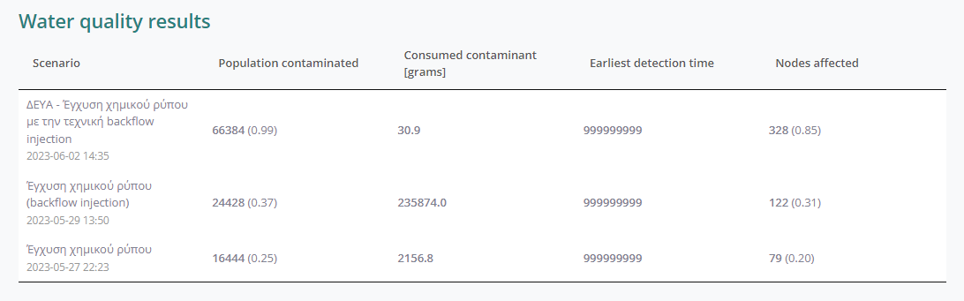
Our Solution: PROCRUSTES
Integrated hub for
cyber-wise water utilities
Identification & quantification of CP risks & vulnerabilities via ABM modelling
Resilient & optimized
water sensor placement
Automated definition of CP attack scenarios
Stochastic scenarios to capture uncertainty
Analysis of alternatives
Risk-reduction measures knowledge database
Cyber-physical stress-testing of water distribution systems

Slide 13
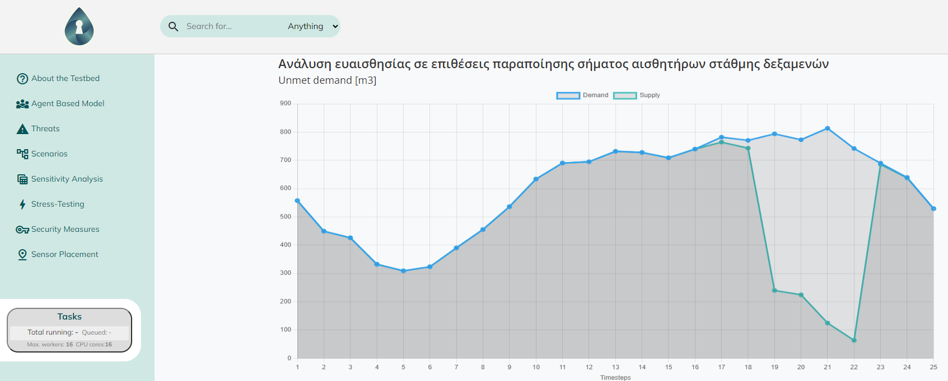
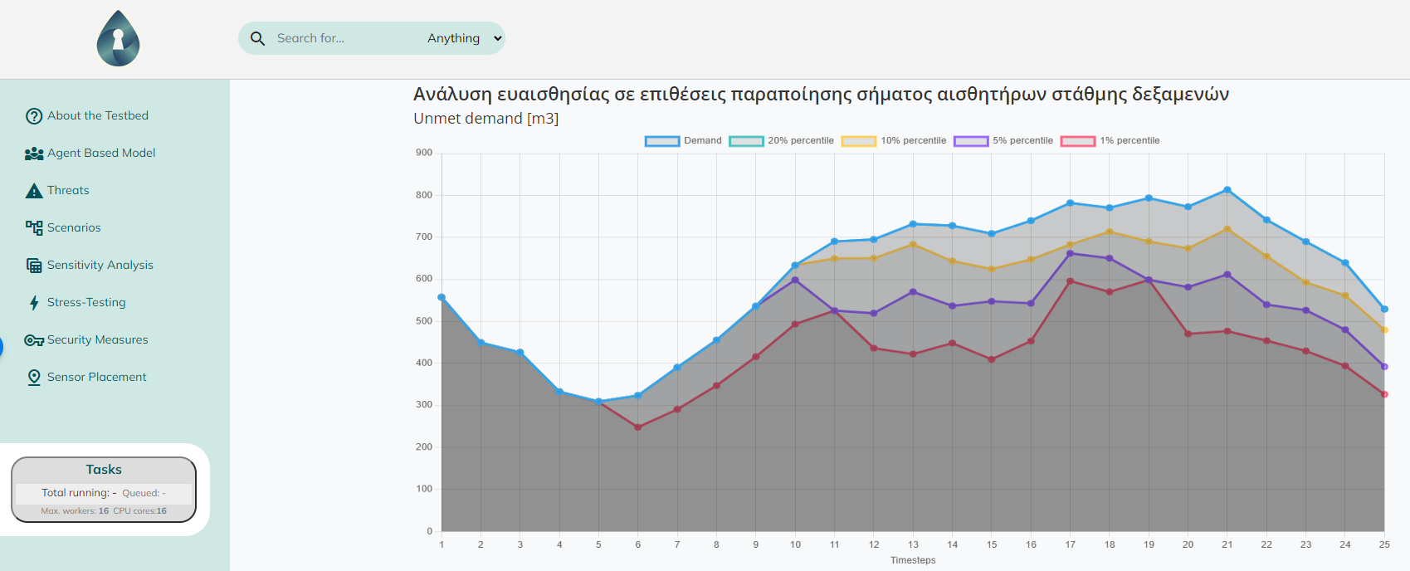
Our Solution: PROCRUSTES
Integrated hub for
cyber-wise water utilities
Identification & quantification of CP risks & vulnerabilities via ABM modelling
Resilient & optimized
water sensor placement
Automated definition of CP attack scenarios
Stochastic scenarios to capture uncertainty
Analysis of alternatives
Risk-reduction measures knowledge database
Cyber-physical stress-testing of water distribution systems

Slide 14
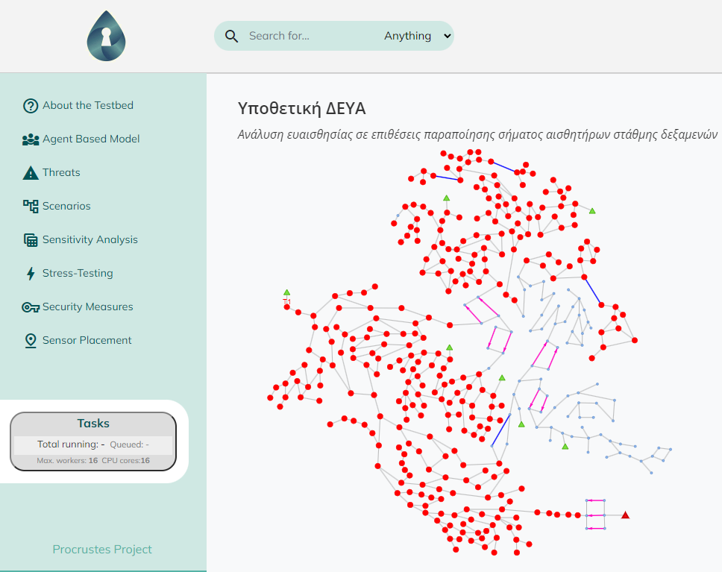
Our Solution: PROCRUSTES
Integrated hub for
cyber-wise water utilities
Identification & quantification of CP risks & vulnerabilities via ABM modelling
Resilient & optimized
water sensor placement
Automated definition of CP attack scenarios
Stochastic scenarios to capture uncertainty
Analysis of alternatives
Risk-reduction measures knowledge database
Cyber-physical stress-testing of water distribution systems

Slide 15
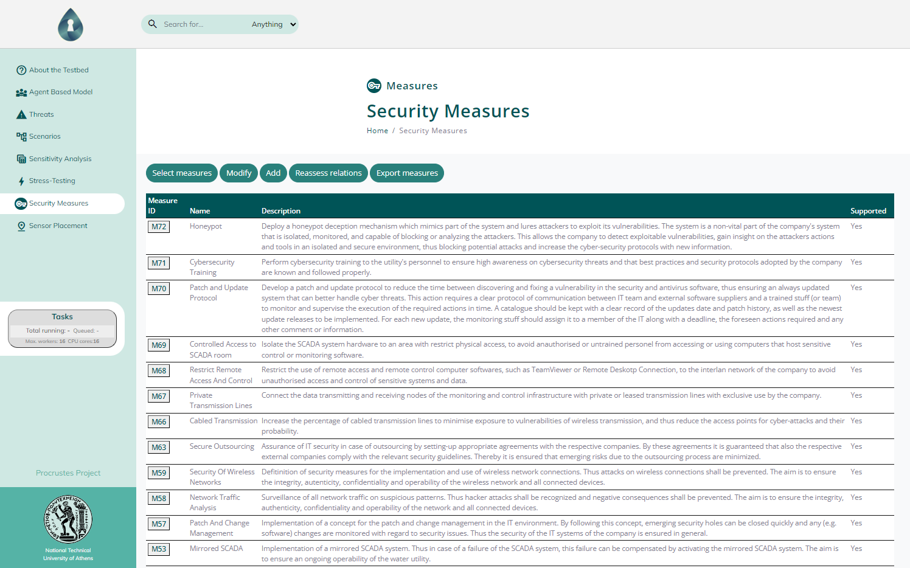
Our Solution: PROCRUSTES
Integrated hub for
cyber-wise water utilities
Identification & quantification of CP risks & vulnerabilities via ABM modelling
Resilient & optimized
water sensor placement
Automated definition of CP attack scenarios
Stochastic scenarios to capture uncertainty
Analysis of alternatives
Risk-reduction measures knowledge database
Cyber-physical stress-testing of water distribution systems

Slide 16
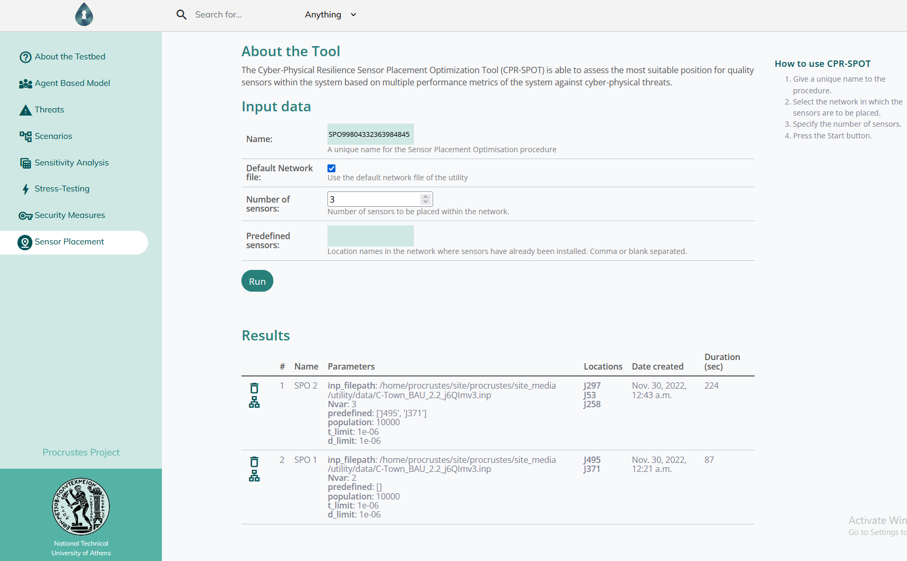
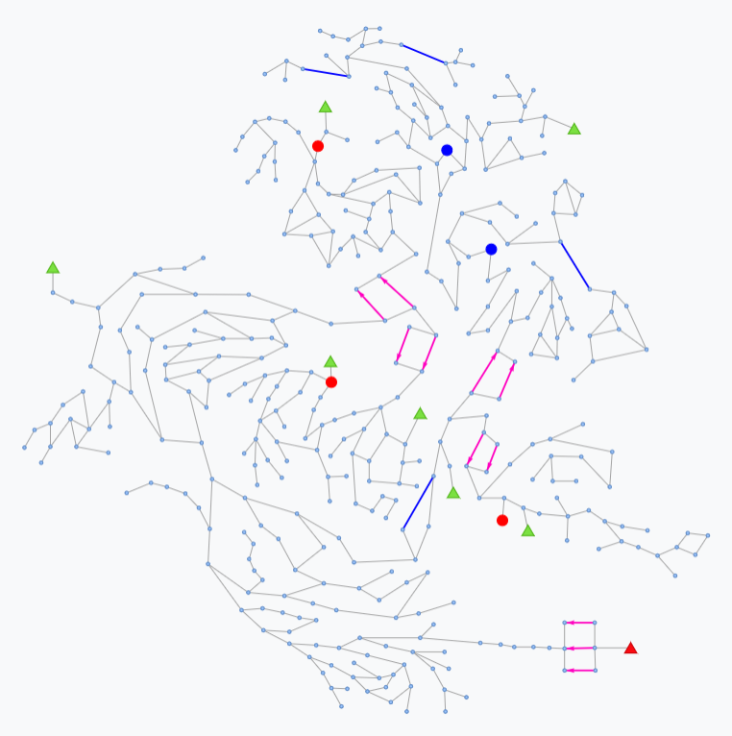
Our Solution: PROCRUSTES
Integrated hub for
cyber-wise water utilities
Identification & quantification of CP risks & vulnerabilities via ABM modelling
Resilient & optimized
water sensor placement
Automated definition of CP attack scenarios
Stochastic scenarios to capture uncertainty
Analysis of alternatives
Risk-reduction measures knowledge database
Cyber-physical stress-testing of water distribution systems

Slide 17




Unique Selling Points
The only all-in-one platform for water cyber-physical resilience assessment, suitable for strategic planning mandated by CER and NIS2 directives.
Dynamic architecture
Multiple-users provision
Internet or Intranet access
Cooperative platform
Different user profiles
Single-view across devices
Interdepartmental workflow
Tiered user access with role-based access and permissions
Secure handling of sensitive data
Parallelization
Modular Architecture
Multi-processing scenarios
Multi-tasking
Enhanced User Experience
Customizable
Scalable
Upgradeable

Slide 18

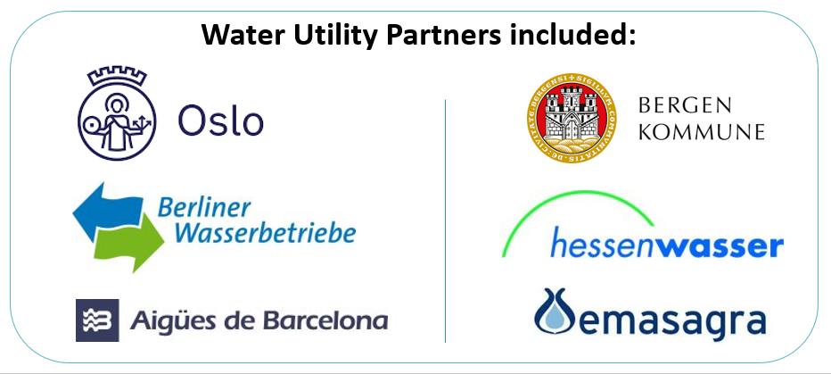
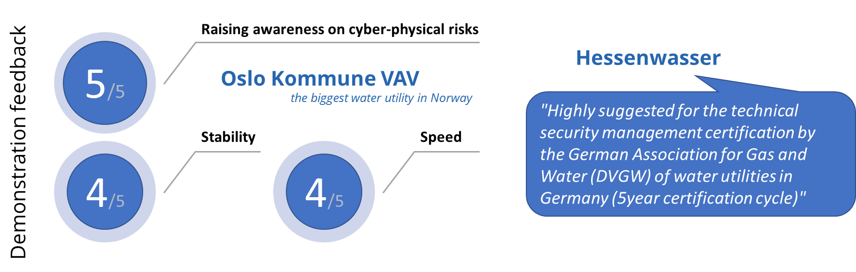
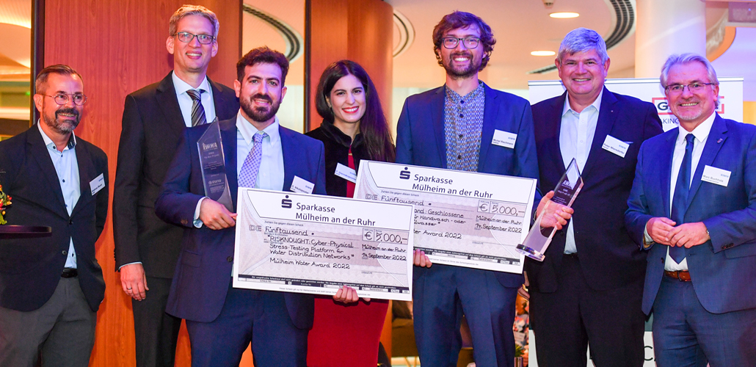
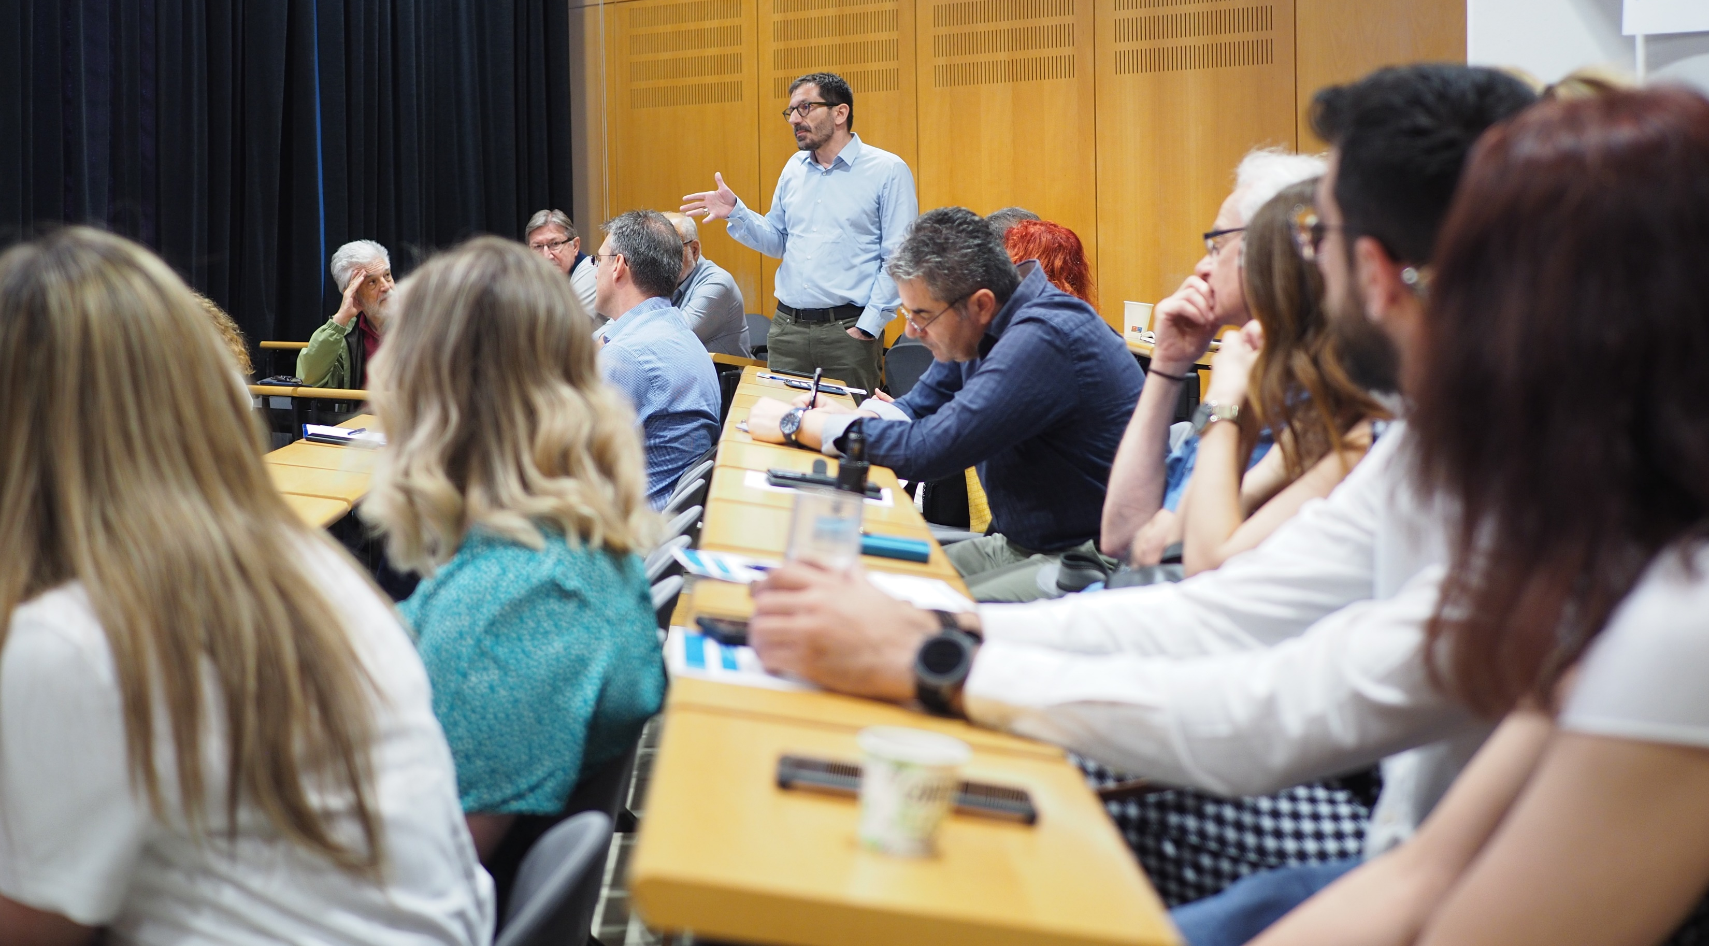
Technological Readiness Level: TRL 6+
PROCRUSTES builds upon the successful H2020 project STOP-IT and the tools RAET and RISKNOUGHT that were developed within it:
User feedback:
https://stop-it-project.eu
Mülheim Water Award 2022 for practice-oriented research on secure water supply for RISKNOUGHT.
Demonstration of PROCRUSTES at the Hellenic Association of Municipal Water & Sewerage Water Utilities.

Slide 19
Market Scan & Early-Adopter Testing
PROCRUSTES can be implemented at any water utility, provided that there exist:
  Computation models for the Water Distribution Network branch of their system (EPANET format or similar)
  High level information of SCADA topology & controls (sensors, actuators, controls, etc.) and cyber-security practices
Demonstrator case (benchmark system –based) ready
PROCRUSTES can be tested and demonstrated in the real world through the collaboration with a reasonably modern water utility. Next steps: scan the market accordingly with help through our network of colleagues and partners ; identify a suitable case to set-up the real-world testing case (already discussing with a Norwegian water utility).

Slide 20

Thank You!
Dr. Dionysios Nikolopoulos
Tethys Consulting (https://tethys-consulting.com)
email: nikolopoulos.dio@gmail.com

